Slide 1
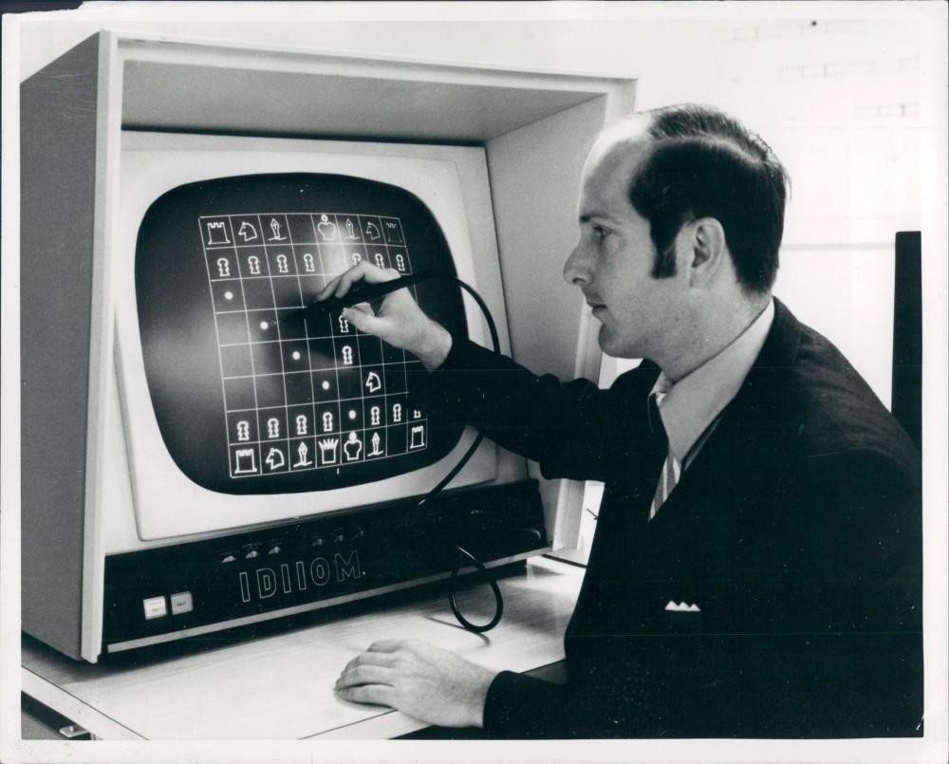
A.I.: Informed Search Algorithms

Slide 2
Outline
Best-first search
Greedy best-first search
A* search
Heuristics

Slide 3
Overview
Informed Search: uses problem-specific knowledge.
General approach: best-first search; an instance of TREE- SEARCH (or GRAPH-SEARCH) – where a search strategy is defined by picking the order of node expansion.
With best-first, node is selected for expansion based on
evaluation function f(n).
Evaluation function is a cost estimate; expand lowest cost node first (same as uniform-cost search but we replace g with f).

Slide 4
Overview (cont’d)
The choice of f determines the search strategy (one can show that best-first tree search includes DFS as a special case).
Often, for best-first algorithms, f is defined in terms of a
heuristic function, h(n).
h(n) = estimated cost of the cheapest path from the state at node n to a goal state. (for goal state: h(n)=0)
Heuristic functions are the most common form in which additional knowledge of the problem is passed to the search algorithm.

Slide 5
Overview (cont’d)
Best-First Search algorithms constitute a large family of algorithms, with different evaluation functions.
– Each has a heuristic function h(n)
Example: in route planning the estimate of the cost of the cheapest path might be the straight line distance between two cities.
Recall:
g(n) = cost from the initial state to the current state n.
h(n) = estimated cost of the cheapest path from node n to a goal node.
f(n) = evaluation function to select a node for expansion (usually the lowest cost node).

Slide 6
Best-First Search
Idea: use an evaluation function f(n) for each node
f(n) provides an estimate for the total cost.
→Expand the node n with smallest f(n).
Implementation:
Order the nodes in the frontier increasing order of cost.
Special cases:
Greedy best-first search
A* search

Slide 7
Greedy best-first search
Evaluation function f(n) = h(n) (heuristic), the estimate of cost from n to goal.
We use the straight-line distance heuristic: h_{SLD}(n) = straight-
line distance from n to Bucharest.
Note that the heuristic values cannot be computed from the problem description itself!
In addition, we require extrinsic knowledge to understand
that h_{SLD} is correlated with the actual road distances, making
it a useful heuristic.
Greedy best-first search expands the node that appears to be closest to goal.

Slide 8
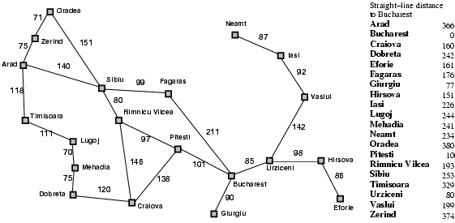
Romania with step costs in km

Slide 9


Greedy best-first search example

Slide 10
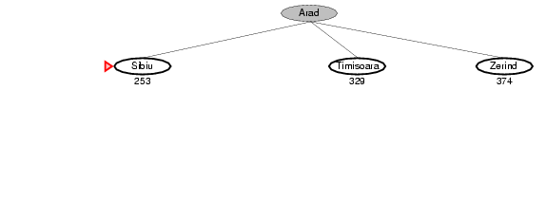
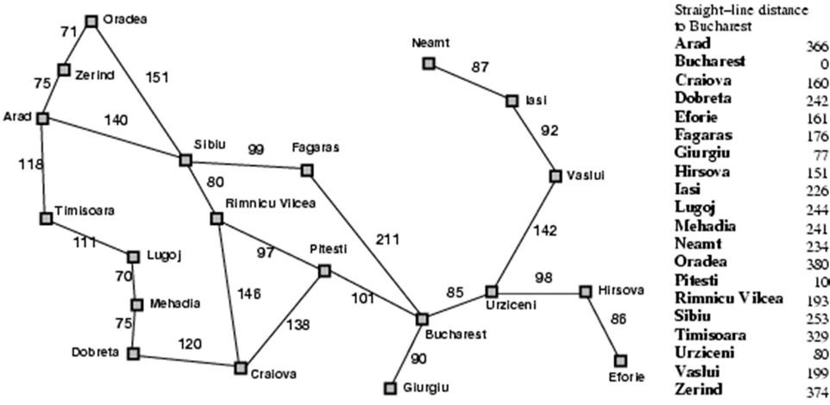
Greedy best-first search example

Slide 11
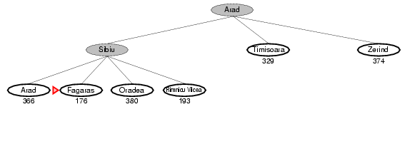
Greedy best-first search example

Slide 12
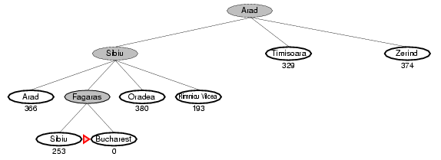
Greedy best-first search example

Slide 13
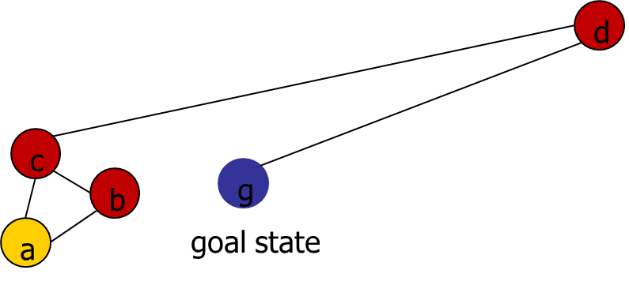
Greedy best-first search
GBFS is incomplete!
Why?
Graph-Search version is, however, complete in finite spaces.

Slide 14
Properties of greedy best-first search
Complete? No – can get stuck in loops, e.g., Iasi
→ Neamt → Iasi → Neamt →
Time? O(b^{m}), (in worst case) but a good heuristic
can give dramatic improvement (m is max depth
of search space).
Space? O(b^{m}) -- keeps all nodes in memory.
Optimal? No (not guaranteed to render lowest
cost solution).

Slide 15
A* Search
Most widely-known form of best-first search.
It evaluates nodes by combining g(n), the cost to reach the node, and h(n), the cost to get from the node to the goal:
f(n) = g(n) + h(n) (estimated cost of cheapest solution through n).
A reasonable strategy: try node with the lowest g(n) + h(n)
value!
Provided heuristic meets some basic conditions, A* is both
complete and optimal.

Slide 16

A* search example
f(n)=g(n)+h(n)

Slide 17
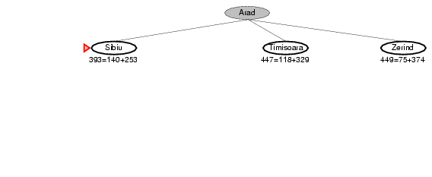
A* search example

Slide 18
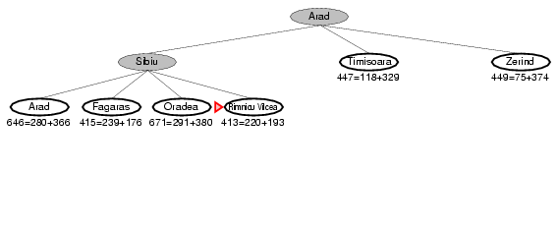
A* search example

Slide 19
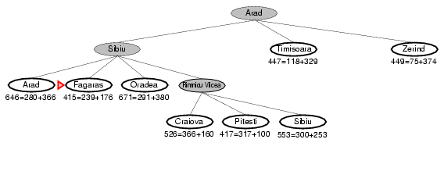
A* search example

Slide 20
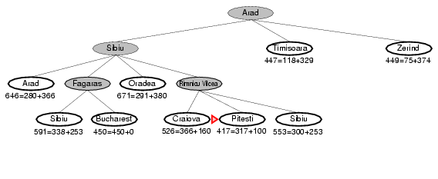
A* search example

Slide 21
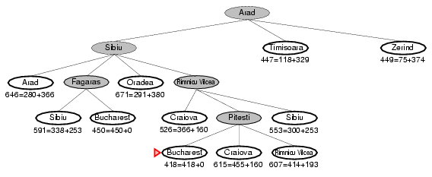
A* search example

Slide 22
Admissible heuristics
A heuristic h(n) is admissible if for every node n,
h(n) ≤ h*(n), where h*(n) is the true cost to reach the goal state from n.
An admissible heuristic never overestimates the cost to reach the goal, i.e., it is optimistic.
Example: h_{SLD}(n) (never overestimates the actual road distance)
Theorem: If h(n) is admissible, A* using TREE- SEARCH is optimal.

Slide 23
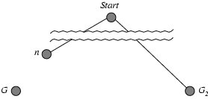
Optimality of A* (proof)
Suppose some suboptimal goal G₂ has been generated and is in the frontier. Let n be an unexpanded node in the frontier such that n is on a shortest path to an optimal goal G.
f(G₂) = g(G₂)
g(G₂) > g(G)
f(G) = g(G)
f(G₂) > f(G)
since h(G₂) = 0
since G₂ is suboptimal
since h(G) = 0 from above

Slide 24
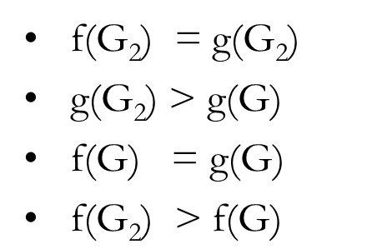
Optimality of A* (proof)
Suppose some suboptimal goal G₂ has been generated and is in the fringe. Let n be an unexpanded node in the fringe such that n is on a shortest path to an optimal goal G.
f(G₂) > f(G)
h(n) ≤ h*(n)
(from above)
(since h is admissible)
-> g(n) + h(n) ≤ g(n) + h*(n)
f(n) ≤ g(n) + h*(n) < f(G) < f(G₂)
Hence f(G₂) > f(n), and A* will never select G₂ for expansion.

Slide 25
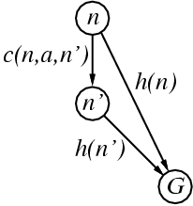
Consistent Heuristics
A heuristic is consistent (or monotonic) if for every node n,
every successor n' of n generated by any action a:
h(n) ≤ c(n,a,n') + h(n')
If h is consistent, we have:
f(n')
= g(n') + h(n')
= g(n) + c(n,a,n') + h(n')
≥ g(n) + h(n)
= f(n)
i.e., f(n) is non-decreasing along any path.
Theorem: If h(n) is consistent, A* using GRAPH-SEARCH is
optimal.

Slide 26
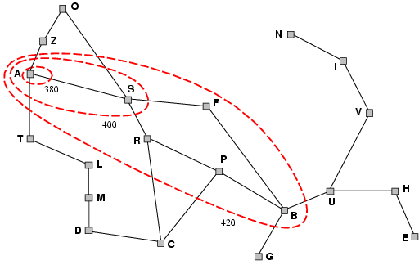
Optimality of A*
A* expands nodes in order of increasing f value.
Gradually adds "f-contours" of nodes.
Contour i has all nodes with f=f_{i}, where f_{i} < f_{i+1.}
That is to say, nodes inside a given contour have f-costs less than or equal to contour value.

Slide 27
Properties of A*
Complete: Yes (unless there are infinitely many nodes with f ≤ f(G) ).
Time: Exponential.
Space: Keeps all nodes in memory, so also exponential.
Optimal: Yes (provided h admissible or consistent).
Optimally Efficient: Yes (no algorithm with the
same heuristic is guaranteed to expand fewer nodes).
NB: Every consistent heuristic is also admissible (Pearl).
Q: What about the converse?

Slide 28
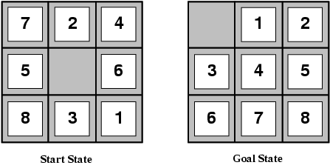
Admissible Heuristics
E.g., for the 8-puzzle:
h₁(n) = number of misplaced tiles
h₂(n) = total Manhattan distance (i.e. 1-norm)
(i.e., no. of squares from desired location of each tile)
Q: Why are these admissible heuristics?
h₁(S) = ?
h₂(S) = ?

Slide 29
Admissible Heuristics
E.g., for the 8-puzzle:
h₁(n) = number of misplaced tiles
h₂(n) = total Manhattan distance
(i.e., no. of squares from desired location of each tile)
h₁(S) = ? 8
h₂(S) = ? 3+1+2+2+2+3+3+2 = 18

Slide 30
Dominance
If h₂(n) ≥ h₁(n) for all n (both admissible), then h₂ dominates
h₁ .
Essentially, domination translates directly into efficiency: “h₂ is better for search.
A* using h₂ will never expand more nodes than A* using h₁.
Typical search costs (average number of nodes expanded):
d=12
IDS = 3,644,035 nodes
A*(h₁) = 227 nodes A*(h₂) = 73 nodes
IDS = too many nodes A*(h₁) = 39,135 nodes
d=24
A*(h₂) = 1,641 nodes
(IDS=iterative deepening search)

Slide 31
Memory Bounded Heuristic Search: Recursive BFS (best-first)
How can we solve the memory problem for A* search?
Idea: Try something like depth-first search, but let’s not forget everything about the branches we have partially explored.
We remember the best f-value we have found so far in the branch we are deleting.

Slide 32
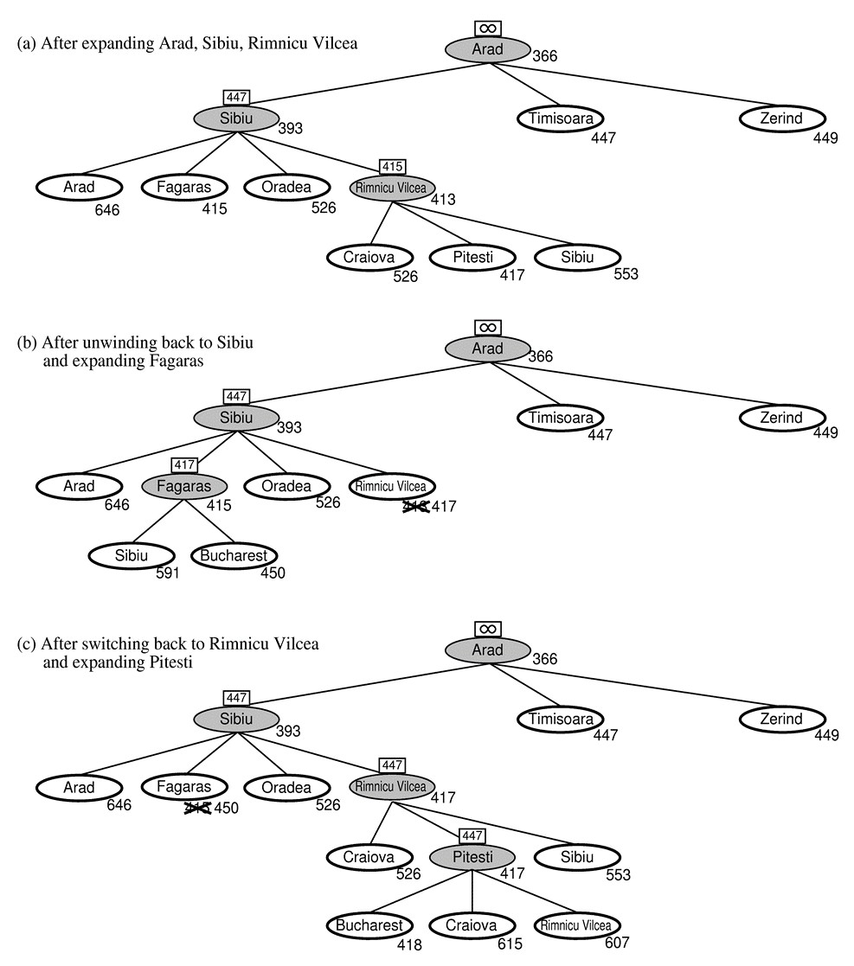
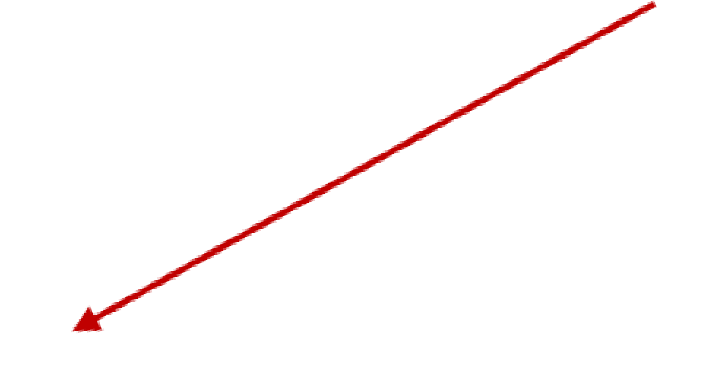
Memory Bounded Heuristic Search:
Recursive BFS
RBFS changes its mind very often in practice. This is because f=g+h become more accurate (less optimistic) as we approach
the goal. Hence, higher level nodes have smaller f-values and
will be explored first.
Best alternative
over frontier nodes, which are not children:
i.e. do I want to back up?
Problem: We should keep
in memory whatever we can.

Slide 33
Simple Memory-Bounded A*
This is like A*, but when memory is full we delete the worst node (largest f-value).
Like RBFS, we remember the best descendent in the branch we delete.
If there is a tie (equal f-values) we delete the oldest nodes first.
Simple-MBA* finds the optimal reachable solution given the memory constraint (reachable means path from root to goal fits in memory).
Can also use iterative deepening with A* (IDA*).
Time can still be exponential.

Slide 34
Relaxed Problems
A problem with fewer restrictions on the actions is called a relaxed problem.
The cost of an optimal solution to a relaxed problem is an admissible heuristic for the original problem. (why?)
If the rules of the 8-puzzle are relaxed so that a tile can move anywhere, then h₁(n) gives the shortest solution.
If the rules are relaxed so that a tile can move to any adjacent square, then h₂(n) gives the shortest solution.

Slide 35
Summary
Informed search methods may have access to a heuristic function h(n) that estimates the cost of a solution from n.
The generic best-first search algorithm selects a node for expansion according to an evaluation function.
Greedy best-first search expands nodes with minimal h(n). It is not optimal, but is often efficient.
A* search expands nodes with minimal f(n)=g(n)+h(n).
A* s complete and optimal, provided that h(n) is admissible (for TREE-SEARCH) or consistent (for GRAPH-SEARCH).
The space complexity of A* is still prohibitive.
The performance of heuristic search algorithms depends on the quality of the h(n) function.
One can sometimes construct good heuristics by relaxing the problem definition.

